Slide 1


Slide 2
ABOUT THE ASSEMBLY
A Smart Lab based out of in5 since December 2014
Over 250 Free workshops done
Assembly : HACK - Embedded systems, IOT, hardware.
Assembly : CODE - Software projects - APIs, frameworks, apps
Assembly: Data Science - Advanced topics related to AI/Machine Learning
Target Audience – Students | Professionals | Entrepreneurs
Focus on Smart Technology and Practical Applications
Forum: members.theassembly.ae

Slide 3
ABOUT THE ASSEMBLY
FACEBOOK
TWITTER
INSTAGRAM
YOUTUBE
The Assembly - @MakeSmartThings
@MakeSmartThings
@MakeSmartThings
The Assembly

Slide 4

INTRODUCTION TO CYBER SECURITY
What is Cyber Security?
What is Ethical Hacking?
Purpose of the workshop
Who can benefit from this?
Workshop Outline

Slide 5
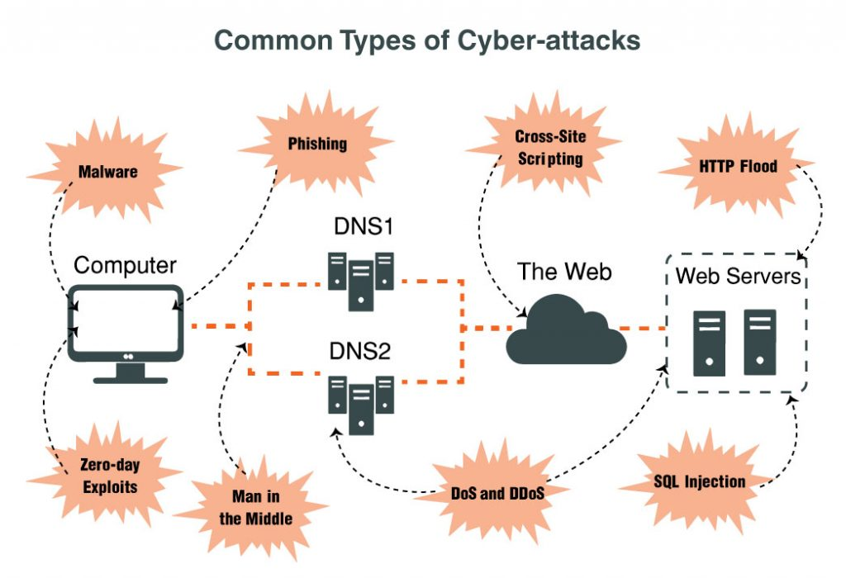

Slide 6
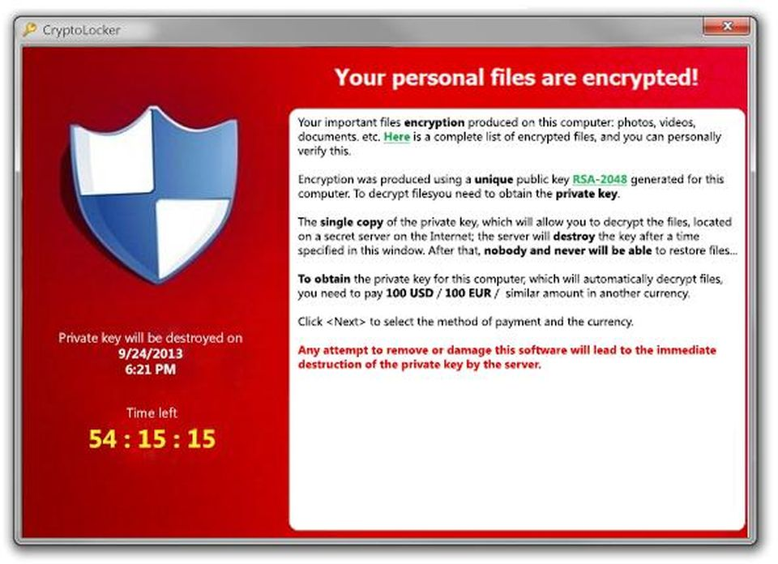
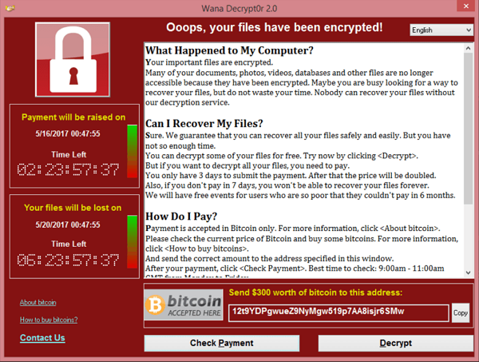
REAL LIFE EXAMPLES
CryptoLocker, ransomware, 2013
WannaCry, ransomware, 2017

Slide 7
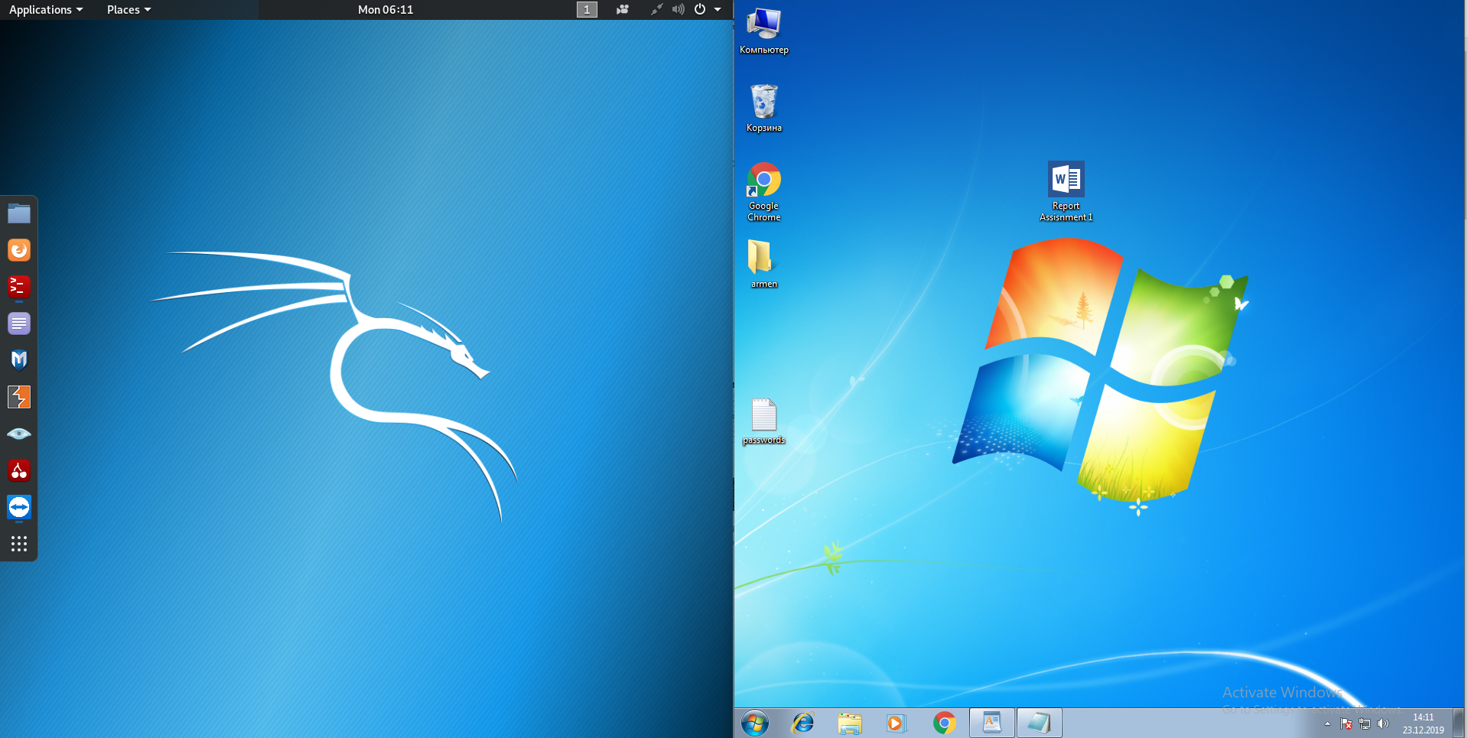
ENVIRONMENT OF OUR ATTACKS

Slide 8

KALI LINUX
Why Kali Linux?
Linux favorite of programmers
Portable
Pre-installed tools
Pre-installed packages
Running on android
Fast and Safe

Slide 9






ATTACKS WE ARE GOING TO COVER
Beef-XSS
Bettercap
Metasploit Framework
Wireshark
SocialFish
Zenmap

Slide 10
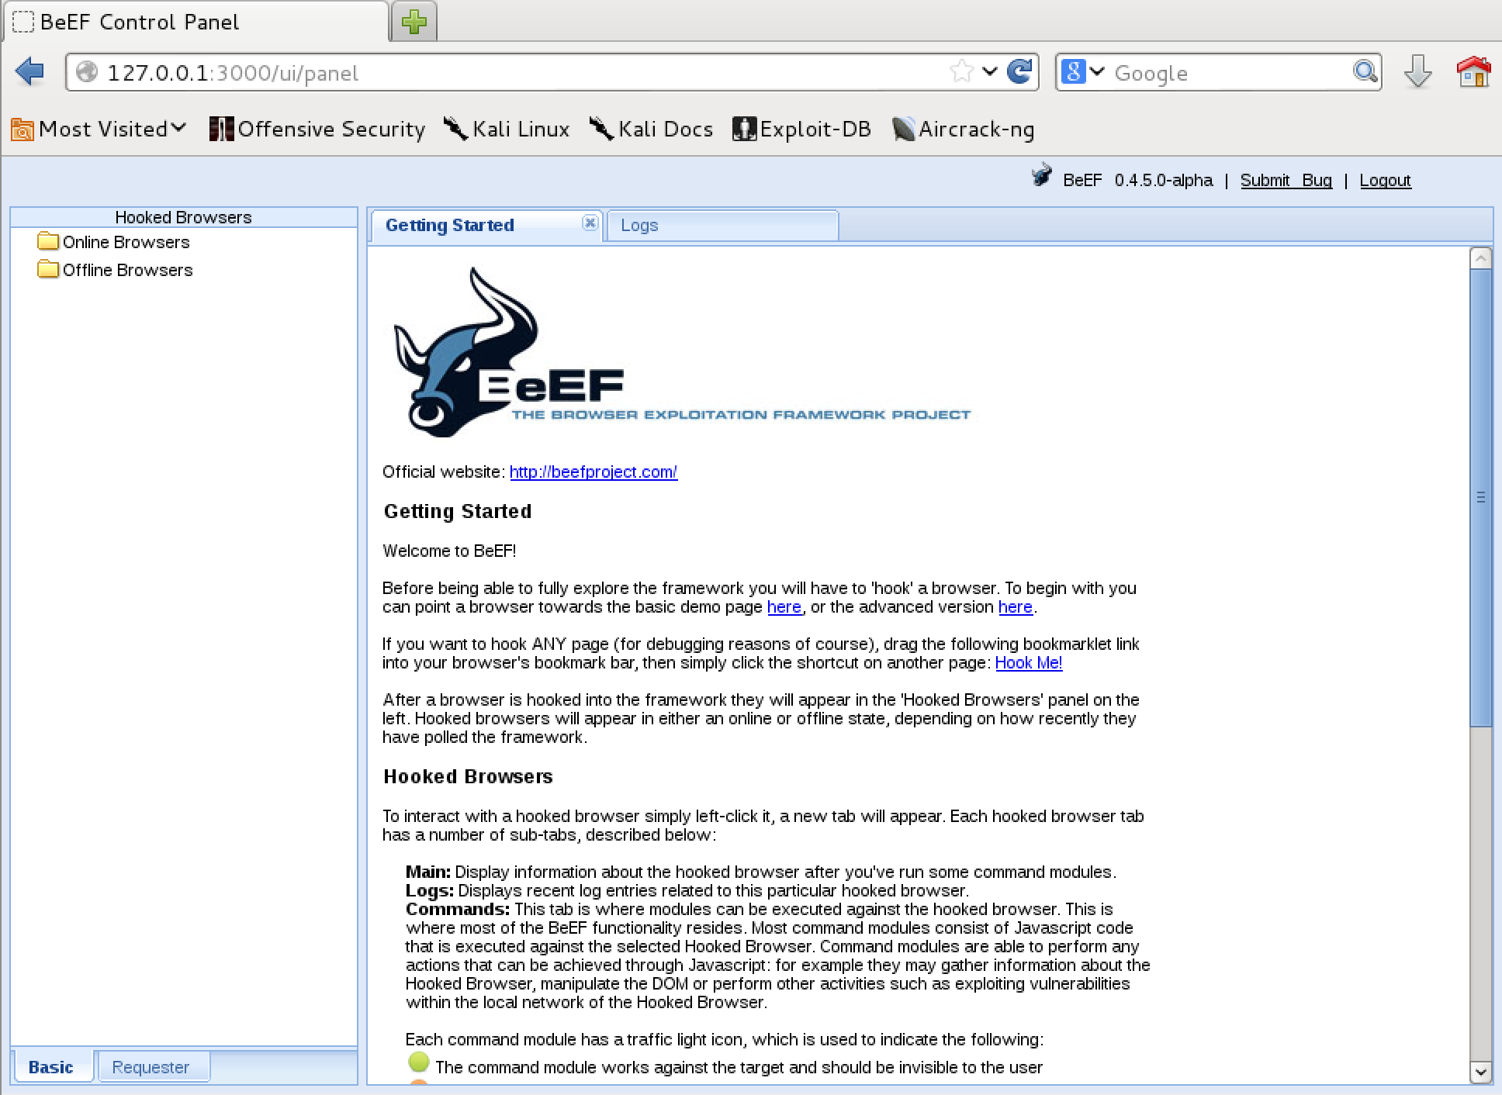
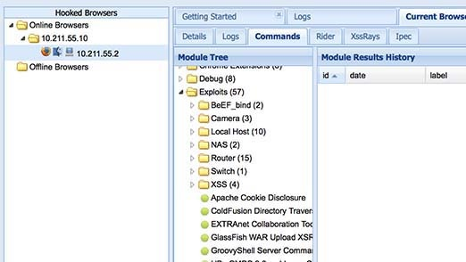
BEEF-XSS (Social Engineering)

Slide 11
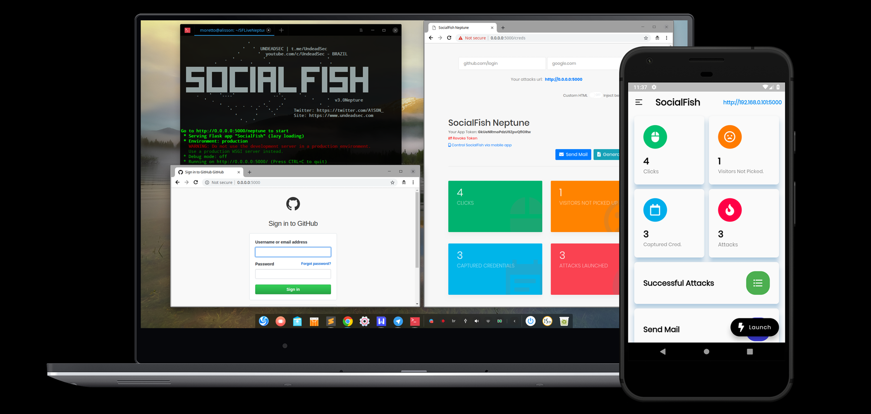
SOCIAL FISH (Social Engineering)

Slide 12
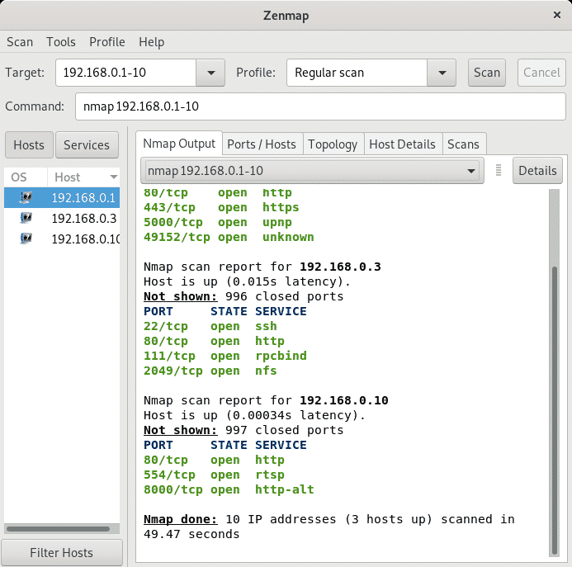
ZENMAP (Information Gathering)

Slide 13
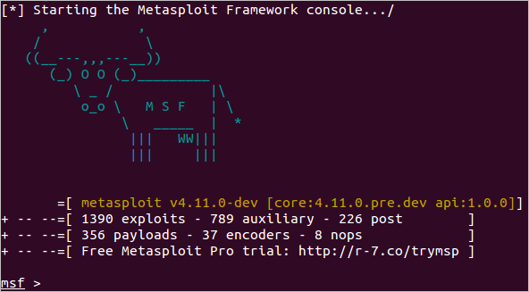
METASPLOIT FRAMEWORK (Exploits)

Slide 14
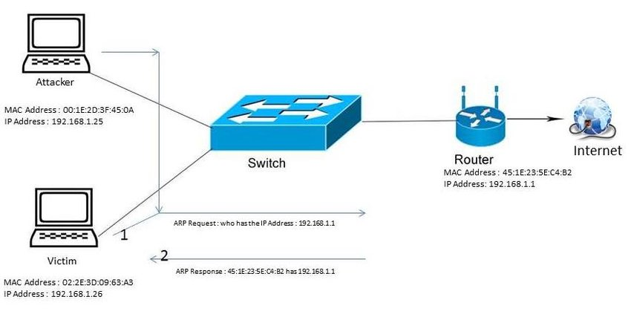
BETTERCAP (MAN IN THE MIDDLE ATTACK)

Slide 15
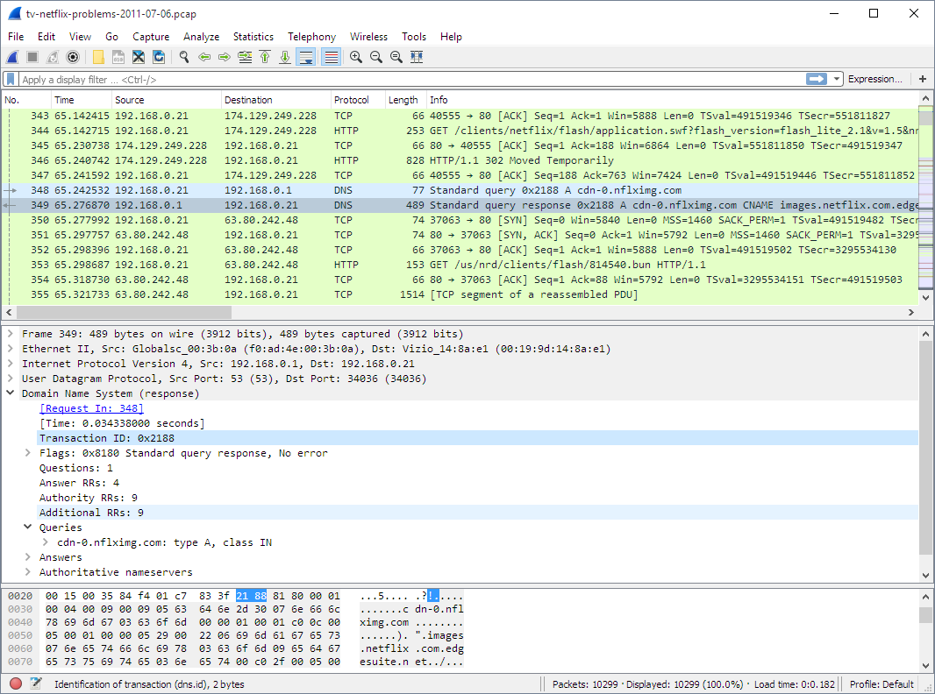
WIRESHARK (Information Gathering)

Slide 16
DEFEND YOURSELF
Xarp against MITM
Wi-Fi security against MITM
Metasploit Framework is poor against updated systems
Do not trust untrusted sources

